Slide 1
Applications of deep uncertainty
魏煜华
2020.9.18

Slide 2
Some papers
《Generative Well-intentioned Networks》(NIPS 2019)
Leveraging uncertainty estimates and generative networks to increase the accuracy of certainty-based models
《Uncertainty Estimation in Deep Neural Networks for Dermoscopic Image Classification》(CVPR 2020)
Applying uncertainty estimation and metrics to the problem of skin lesion classification
《Multi-Task Learning Using Uncertainty to Weigh Losses for Scene Geometry and Semantics》
Applying aleatoric homoscedastic uncertainty to multi-task learning.
《On uncertainty estimation in active learning for image segmentation》(ICML 2020 UDL workshop)
Combining uncertainty estimation and active learning for image segmentation
《Bayesian SegNet: Model uncertainty in Deep Convolutional Encoder-Decoder Architectures for Scene Understanding》(NIPS 2017)
《Uncertainty guided semi-supervised segmentation of retinal layers in OCT images》(MICCAI 2019)
《U-CAM: Visual Explanation using Uncertainty based Class Activation Maps 》(ICCV 2019)

Slide 3
《Generative Well-intentioned Networks》(NIPS 2019)
A conditional generative network recovers the distribution of observations that the classifier labels correctly with high certainty. 用一个conditional generative 网络来recover 分类器以高确定性正确分类的样本的distribution
Introduce a reject option to the classifier during inference, allowing the classifier to reject an observation instance rather than predict an uncertain label. 在推理过程中向分类器引入reject选项，允许分类器拒绝观察实例，而不是预测不确定的标签。
These rejected observations are translated by the generative network to high-certainty representations, which are then relabeled by the classifier. 生成网络将这些被拒绝的观察值转换为高确定性表示，然后由分类器重新给出其标签。

Slide 4
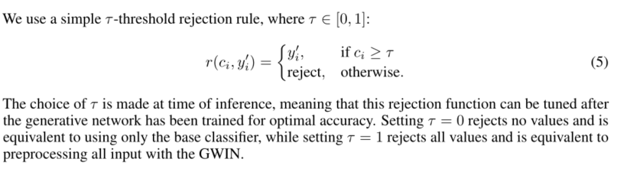
Classification with rejection
The problem of classification with rejection can be informally defined as giving the classifier the option to reject an observation instance instead of predicting its label. 带有拒绝的分类问题可以定义为给予分类器拒绝观察实例的选项，而不是预测其标签。
Threshold rejection: 给定阈值τ，如果正确预测的确定性小于τ，则拒绝观察实例。
Notes:
拒绝分类背后的动机是为了避免在高风险情况下，如医学诊断中的错误分类，当分类器对其预测的正确性不高时

Slide 5
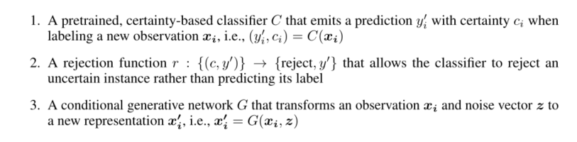
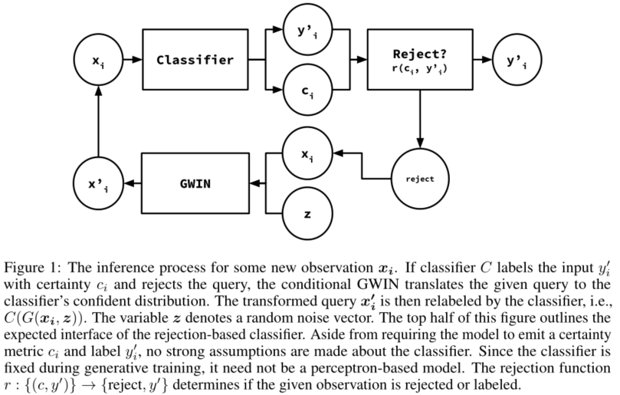
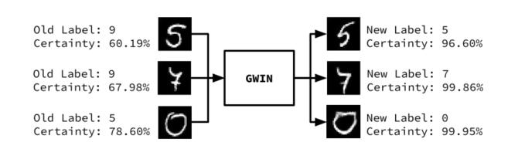
Generative Well-intentioned Network Framework
Notes:
如果分类器以ci的确定度给出输入xi的分类标签yi并拒绝query，那么就用conditional GWIN把given query translate到分类器的confident distribution。

Slide 6
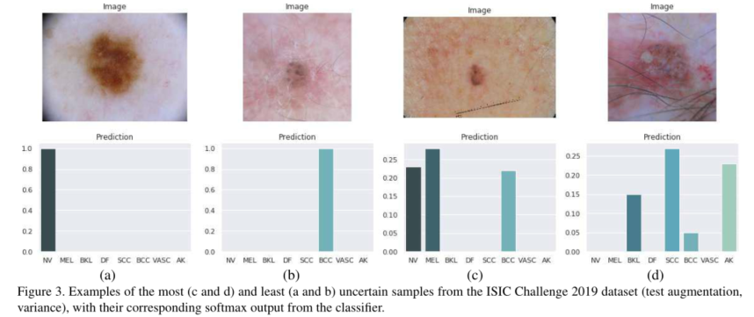
《Uncertainty Estimation in Deep Neural Networks for Dermoscopic Image Classification》(CVPR 2020)
Explore the use of uncertainty estimation techniques and metrics for deep neural networks based on Monte-Carlo sampling.
Apply the above uncertainty method to the problem of skin lesion classification (ISIC 2018 and ISIC 2019)
Results show the uncertainty metrics can be successfully used to detect difficult and out-of-distribution samples.

Slide 7
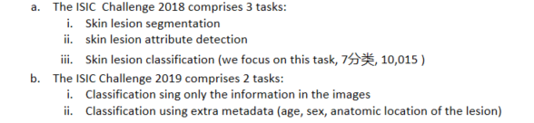
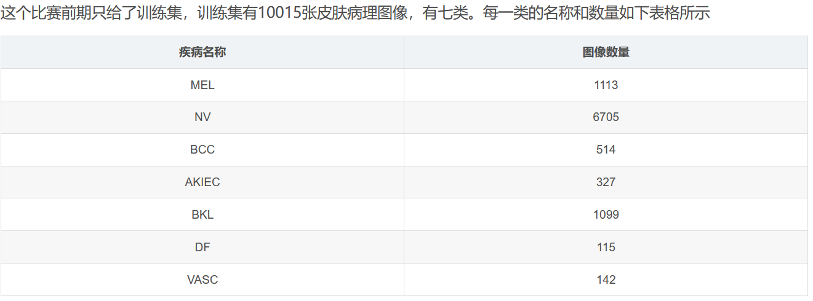
Materials and Method
ISIC 2018 (2019) Challenge Dataset
https://blog.csdn.net/a1054513777/article/details/82855950

Slide 8
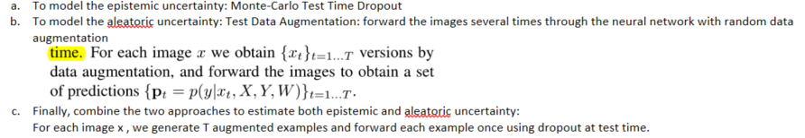

Materials and Method
Uncertainty methods
Ucertainty measures

Slide 9
Experiments and Results
Conduct experiments to study how the uncertainty metrics can be used to identify difficult to classify and out-of-distribution samples.
All the classifiers used in these experiments are based in the Efficient-Net-B0.
To account for the severe class imbalance present in the datasets, we use weighted sampling to construct a uniform class distribution in the training batches. ( Learning to reweight examples for robust deep learning)

Slide 10
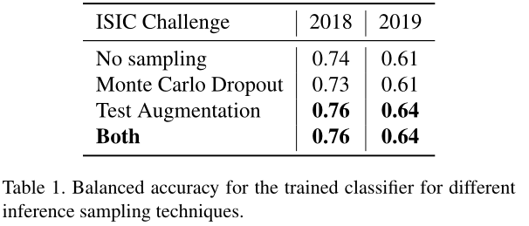
Experiment 1 - Uncertainty as a measure of confidence
Settings
Train two classifiers for the problems of ISIC 2018 and 2019, respectively.
Data division: train(64%) validation(16%) test (20%)
During inference, forward each image T = 100 times through the neural network using Test Augmentation, Test Time Dropout, and both.
Obtaining predictions for the classifiers by averaging the output softmax vector over the T forward passes an compute the uncertainty of each prediction based on the methods described above.
Balanced accuracy

Slide 11
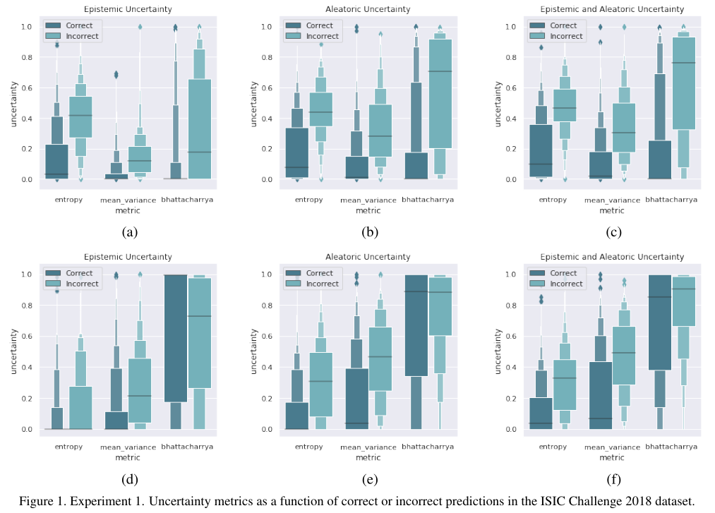
Experiment 1 - Uncertainty as a measure of confidence
Uncertainty metrics as a function of correct or incorrect predictions

Slide 12
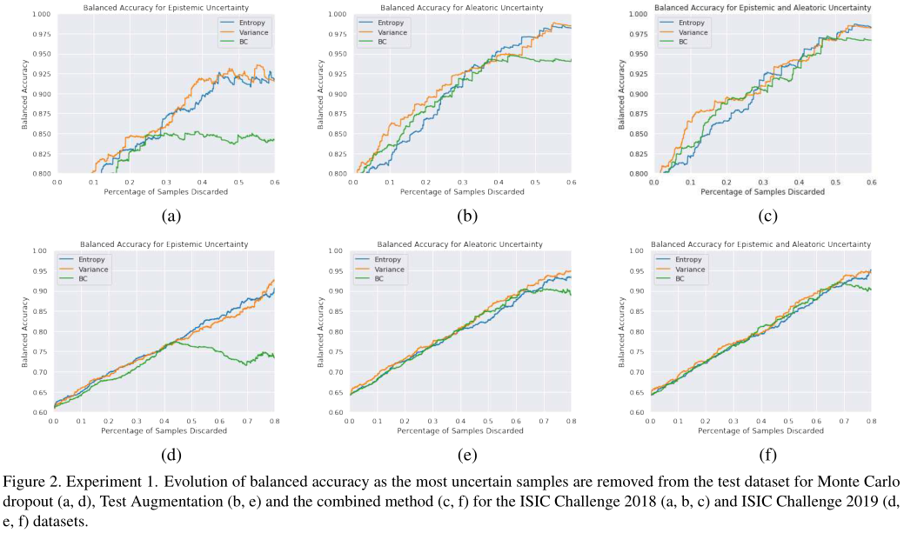
Experiment 1 - Uncertainty as a measure of confidence
The evolution in balanced acc as iteratively discard the most uncertain samples from the test dataset.

Slide 13
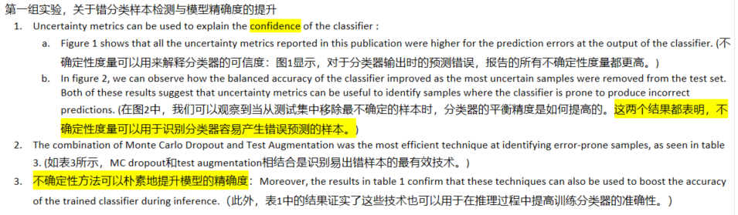
Discussion

Slide 14
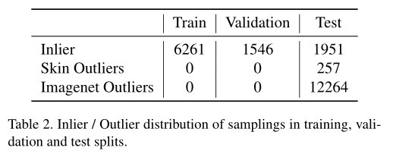
Experiment 2 - Uncertainty to detect out-of-distribution samples
This experiment aims to determine if we can use the uncertainty metrics to detect out-of-distribution samples, that is, samples from diagnostic categories that are not present in the training set.
ISIC Challenge 2018
Move a subset of classes from the training set to the test set, train the network with the reduced training set
Concretely, move the Dermatofibroma and Vascular Lesion categories from the training dataset to the test set. We also add 12264 images from the Imagenet dataset to the test split , to compare the magnitude of uncertainty metrics for images from a completely different domain. (OoD 数据由两部分组成：为在训练数据中未出现的类 + ImageNet中的数据， 完全不同的数据分布), sample distribution across the train, validation and test splits.

Slide 15
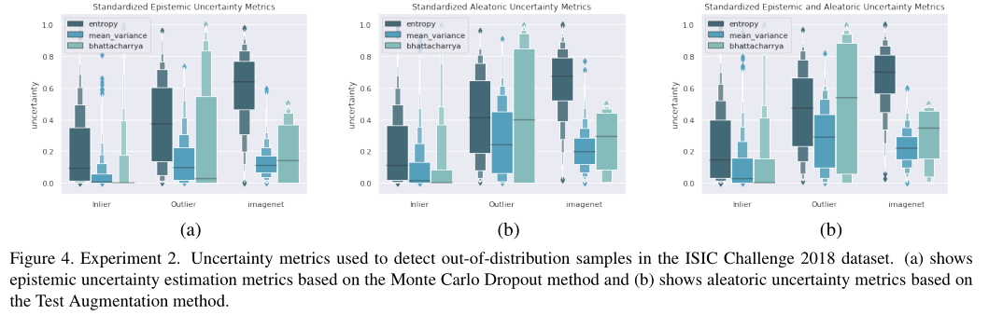
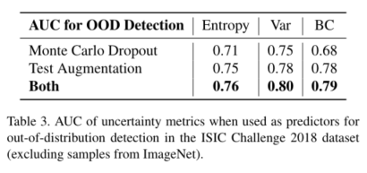
Experiment 2 - Uncertainty to detect out-of-distribution samples
Uncertainty metrics stratified by in-distribution and out-distribution categories
the AUC for each uncertainty metrics when used as predictor for OoD detection (ignoring ImageNet)

Slide 16
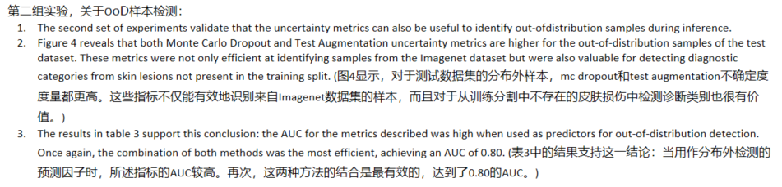
Discussion

Slide 17
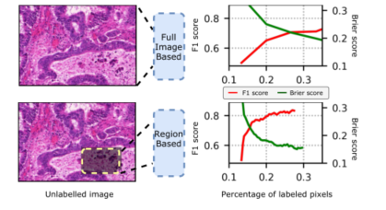
《On uncertainty estimation in active learning for image segmentation》(ICML 2020 UDL workshop)
Uncertainty estimation is important for machine learning models. This is especially critical in the data-driven active learning setting where the goal is to achieve a certain accuracy with minimum labeling effort. 在数据驱动的主动学习环境中，这一点尤其重要，因为数据驱动的主动学习的目标是以最小的标记工作量实现一定的准确性。
In such settings, the model learns to select the most informative unlabeled samples for annotation based on its estimated uncertainty. The highly uncertain predictions are assumed to be more informative for improving model performance. 在这种情况下，模型学习根据估计的不确定性选择信息最丰富的未标记样本进行注释。假设高度不确定性的预测对于改善模型性能更为有用。
This paper explore uncertainty calibration within an active learning framework for medical image segmentation.
Various uncertainty estimation methods and acquisition strategies (regions and full images) are investigated.研究了各种不确定性估计方法和获取策略（区域和全图像）
Selecting regions to annotate instead of full images leads to more well-calibrated models.

Slide 18
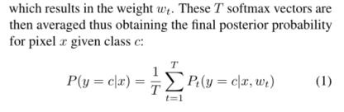
Method
The architecture of neural network
Use ResNet-50 as the feature extractor and employs the decoder of the DCAN model to accomplish the image segmentation with auxiliary tasks.
(dropout layers are added before each residual block)
Evaluation metrics: F1 score, object-level Dice index, and Jaccard index
Uncertainty estimation methods (Monte-Carlo Dropout (MC-Dropout))

Slide 19
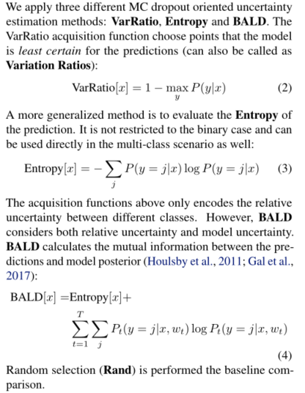
Method
Different Uncertainty estimation

Slide 20
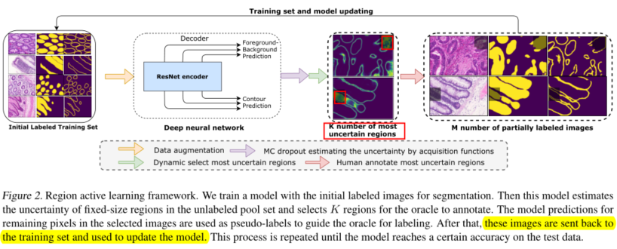
Method
The framework for the region acquisition
The model learns to acquire annotation of pixels in the most uncertain regions instead of the full image
The prediction of the remaining pixels can be used to guide the oracle for labeling the pixels in the required regions.
Only the loss for the human-annotated regions is back-propagated.

Slide 21
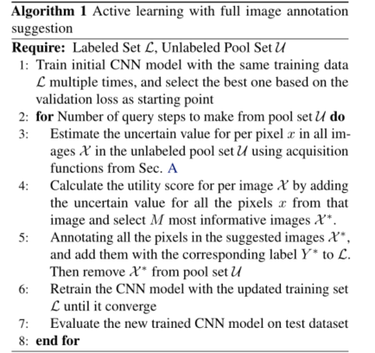
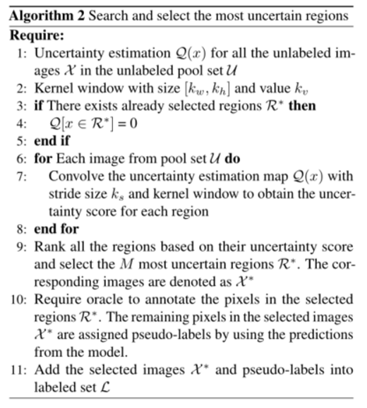
Method
Algorithm 1 and 2

Slide 22
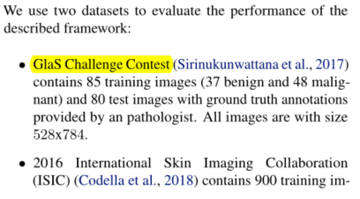
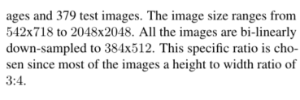
Experiments

Slide 23
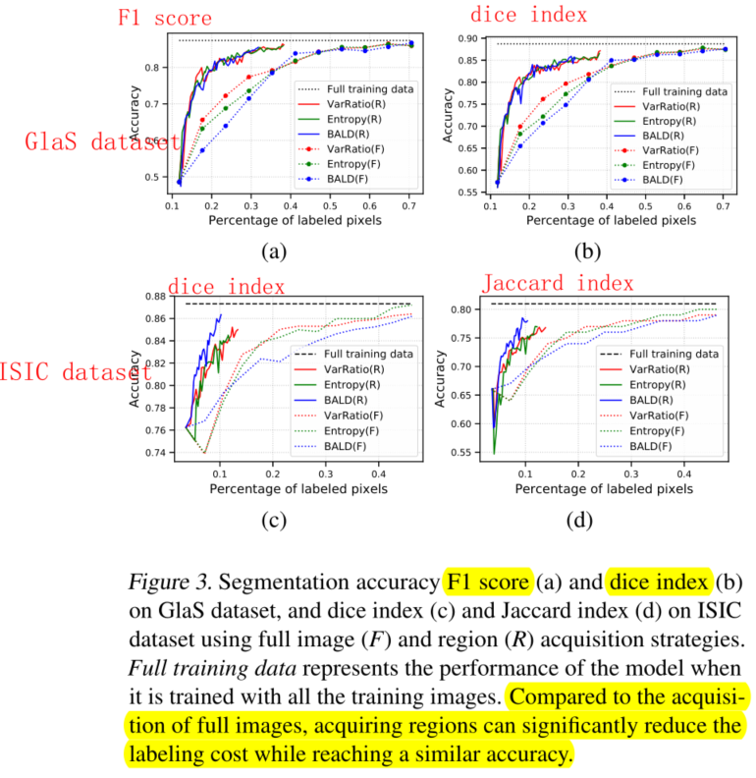
Results
Segmentation
accuracy
Notes:
1. 与全图像获取策略相比，区域获取策略将所需的注释像素量减少到2倍，以达到限制性能。
2. 对于基于区域的采集，与其他两种方法相比，BALD采集函数进一步减少了对ISIC数据集的标记工作。
3. 然而，注释策略的效果远远超过了效果获取函数的选择。

Slide 24
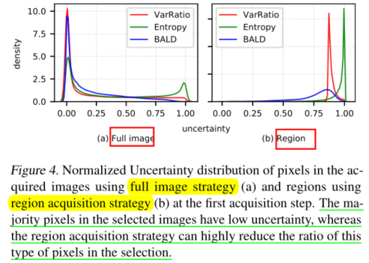
Results
Why region annotation is more efficient than the full image annotation? How uncertainty estimates are distributed in the images selected for annotation.
Notes:
1. 所选图像中的大多数像素具有相当低的不确定性，这意味着模型正在查询oracle来标记大量像素，这些像素很有可能已经被模型正确预测。
2. 而region acquisition 方法可以显著降低不确定性像素的比例。

Slide 25
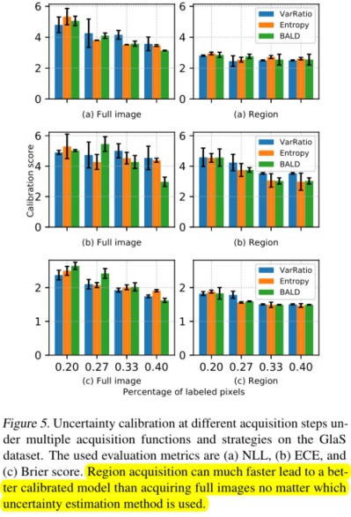
Results
Uncertainty calibration at different acquisition steps under multiple acquisition functions and strategies on the GlaS dataset
Notes:
1. Region annotation much faster leads to a well-calibrated model compared to full image annotation regardless of the evaluation metric. 与全图像标注相比，无论评价尺度如何，区域标注的速度要快得多，从而得到一个校准良好的模型。
2. The change of the uncertainty calibration quality in Figure E.2 follows the increment of the segmentation accuracy as shown in Figure 3. It indicates that a well-calibrate model can further boost the efficiency and effectiveness of the active learning acquisition process. 图E.2中不确定度校准质量的变化遵循图3所示分割精度的增加。结果表明，一个良好的标定模型可以进一步提高主动学习获取过程的效率和有效性。

Slide 26
《Uncertainty guided semi-supervised segmentation of retinal layers in OCT images》(MICCAI 2019)
The usual problem when training supervised deep learning methods is the lack of labeled data which is time-consuming and costly to obtain.
In this paper, we propose a novel uncertainty guided semi-supervised learning based on student-teacher approach for training the segmentation network using limited labeled samples and large number of unlabeled images. 本文提出了一种新的基于学生-教师的不确定性引导半监督学习方法，利用有限的标记样本和大量未标记图像训练分割网络。
Experimental results on a retinal layer segmentation task show that the proposed method improves the segmentation performance in comparison to the fully supervised approach and is on par with the expert annotator.实验结果表明，与全监督方法相比，该方法提高了视网膜层分割的性能，与专家注释器的效果相当。

Slide 27
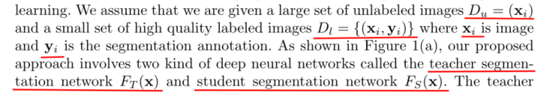
Method
The proposed method consists of two components:
student segmentation network which is responsible for learning suitable data representation and learning the main segmentation task.
teacher segmentation network which controls the learning of the student network by modeling the unreliability in segmentation prediction.

Slide 28
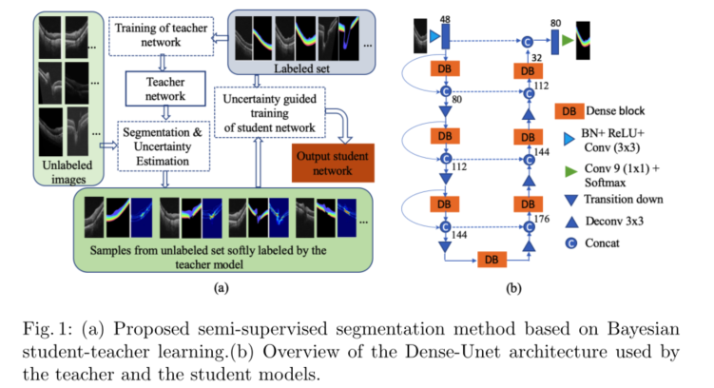
Method
The teacher network is trained using labeled dataset based on Bayesian deep learning to output both segmentation map as well as uncertainty map.
The teacher network is then applied to each image in the unlabeled set to obtain the segmentation label and associated uncertainty map to generate the softly labeled samples.
The uncertainty map captures the pixel-wise confidence values indicating the reliability of the segmentation output from the teacher network and it is used to guide the training of the student network learning.
Network Architecture: use DenseNet architecture as base model for both teacher and student networks.

Slide 29
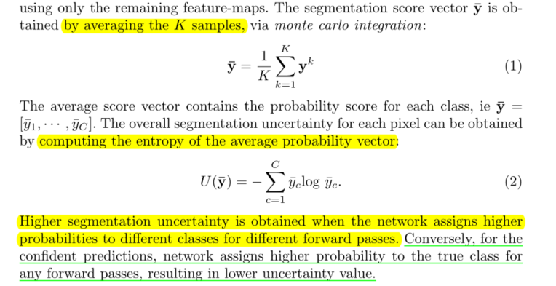
Teacher Segmentation Network as a Bayesian Model
First, train the teacher network from the labeled samples set using the class weighted categorical cross entropy loss.
For segmentation and uncertainty quantification, we enable the dropout in test phase. (MC dropout).

Slide 30


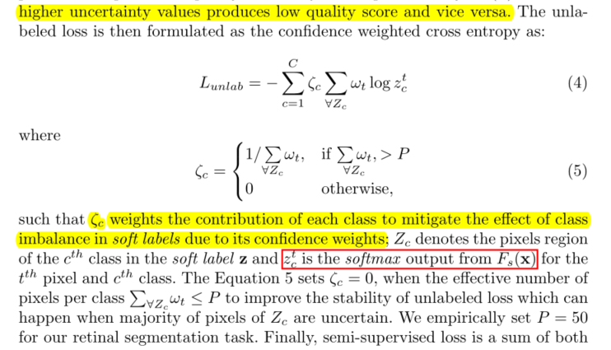
Uncertainty Guided Learning of Student Network
We first apply FT(x) to the unlabeled images xu∈ U to obtain the soft segmentation map z using Equation (1) and the associated segmentation uncertainty map u using Equation (2).
Then convert the uncertainty map u to normalized confidence map:
The unlabeled loss:

Slide 31
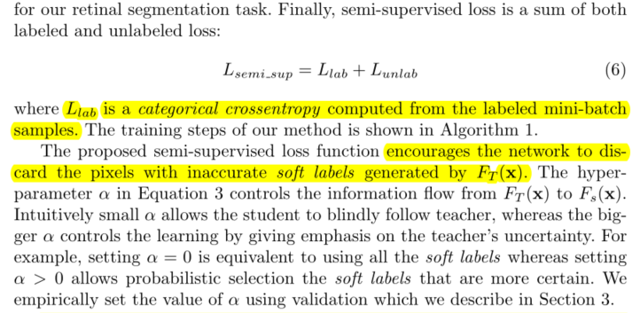
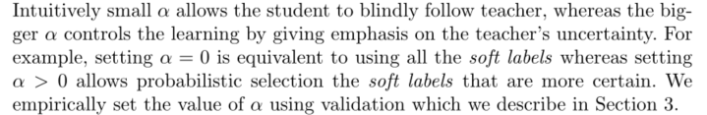
Uncertainty Guided Learning of Student Network
The semi-supervised loss (total loss):
Notes:
loss分析：
1. The proposed semi-supervised loss encourages the network to discard the pixels with inaccurate soft labels generated by the teacher network.
2. The alpha in Equation (3) controls the information from teacher to student network, Intuitively small α allows the student to blindly follow teacher, whereas the bigger α controls the learning by giving emphasis on the teacher’s uncertainty.
直觉上小α允许学生盲目跟随老师，而大α通过强调教师的不确定性来控制学习。例如，设置α=0相当于使用所有软标签，而设置α>0允许概率选择更确定的软标签。我们使用我们在第3节中描述的验证来经验地设置α的值。

Slide 32
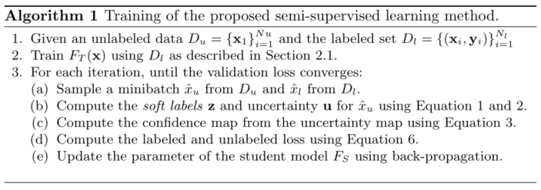
Uncertainty Guided Learning of Student Network
Training steps:

Slide 33
Experiments
The dataset consists of 570 spectral-domain optical coherence tomography (OCT) optic nerve volumes.
Labeled set: 700 images (490 train 70 validation 140 test)
Unlabeled set: 10000 images
Compare between:
(1) proposed uncertainty guided semi-supervised layer segmentation (U-SLS)
(2) baseline fully supervised Dense-Unet (FS-DU)
(3) plain semi-supervised learning (Plain-SL) that blindly follows the teacher model without taking uncertainty into account, i.e., for the case where alpha=0 in Equation 3
Notes:
光谱阈光学相干层析（OCT）

Slide 34
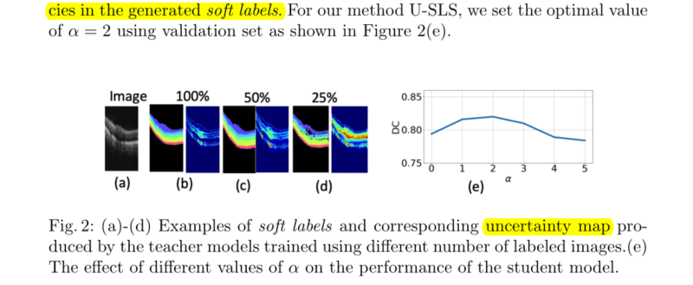
Experiments
Example of soft labels and uncertainty maps produced by the teacher model.
Notes:
Figure 2 (b)-(d) shows he examples of soft labels and uncertainty maps produced by the teacher model FT(x) on an unlabeled image. It can be seen that the teacher model trained on less number of labeled data produces less accurate soft labels and the corresponding uncertainty map correlates with the inaccuracies in the generated soft labels.
(图2（b）-（d）显示了由教师模型FT（x）在未标记图像上生成的软标签和不确定度映射的示例。可以看出，在较少的标记数据上训练的教师模型产生的软标签不太准确，相应的不确定性映射与生成的软标签中的不精确性相关。)

Slide 35
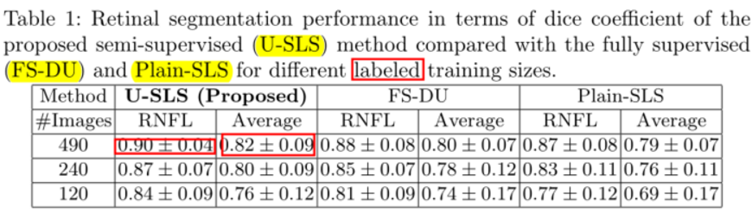
Experiments
Retinal segmentation performance in terms of dice coefficient
The proposed U-SLS resulted in average DC of 0.90 for RNFL layer and 0.82 across all 8 layers.
The proposed approach improves the segmentation performance of when the number of the labeled images are limited.
The lower performance of Plain-SLS shows that student model is corrupted by the soft labels when uncertainty is not taken into account. U-SLS improves the performance by uncertainty guided learning from the unlabeled samples.

Slide 36
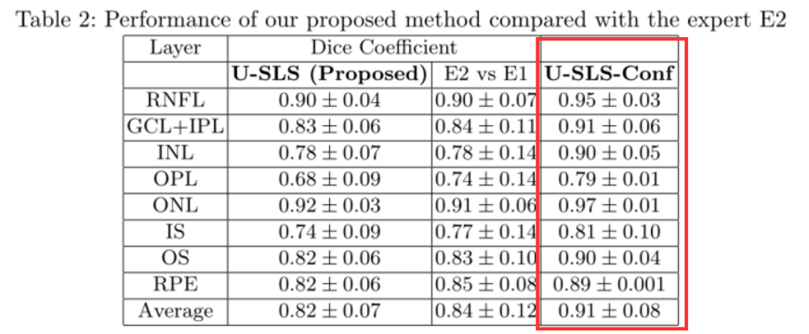
Experiments
Performance of the proposed method compared to human expert
Performance of our method is on par with the human expert for most of the layers, including RNFl, GCL+IPL, INL, ONL and OS.
We also report the confident version of our method (U-SLSConf) by evaluating on the pixels whose confidence score ω > 0.5 (computed using Equation 3) which comprises 95% of the total number of pixels on average. As expected, U-SLS-Conf significantly improves over U-SLS which shows that the uncertainty measure produced by our method highly correlates with the segmentation inaccuracies.

Slide 37
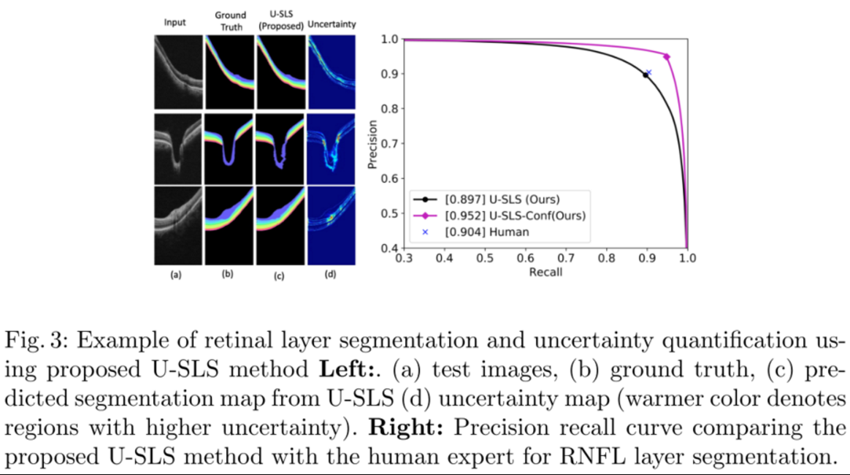
Experiments
Examples of the retinal layers segmentation and the generated uncertainty map:
This shows that performance U-SLS is comparable with the human expert, whereas the confident version, U-SLS-Conf exceeded the human expert.

